Slide 1
Flyweight Design Pattern
The Flyweight pattern is a classical structural solution for optimizing code that is repetitive, slow, and inefficiently shares data.
It aims to minimize the use of memory in an application by sharing as much data as possible with related objects (e.g application configuration, state, and so on).
The pattern was first conceived by Paul Calder and Mark Linton in 1990.
@ShankaragoudaG

Slide 2
Usage
The first is at the data-layer, where we deal with the concept of sharing data between large quantities of similar objects stored in memory.
The second is at the DOM-layer where the Flyweight can be used as a central event-manager to avoid attaching event handlers to every child element in a parent container we wish to have some similar behavior.

Slide 3
Flyweight Pattern States
Intrinsic state information may be required by internal methods in our objects which they absolutely cannot function without.
Extrinsic state information can however be removed and stored externally.

Slide 4
Example
Flyweight Pattern is within the JavaScript engine itself which maintains a list of immutable strings that are shared across the application.
Other examples include characters and line-styles in a word processor, or 'digit receivers' in a public switched telephone network application. You will find flyweights mostly in utility type applications such as word processors, graphics programs, and network apps; they are less often used in data-driven business type applications.

Slide 5
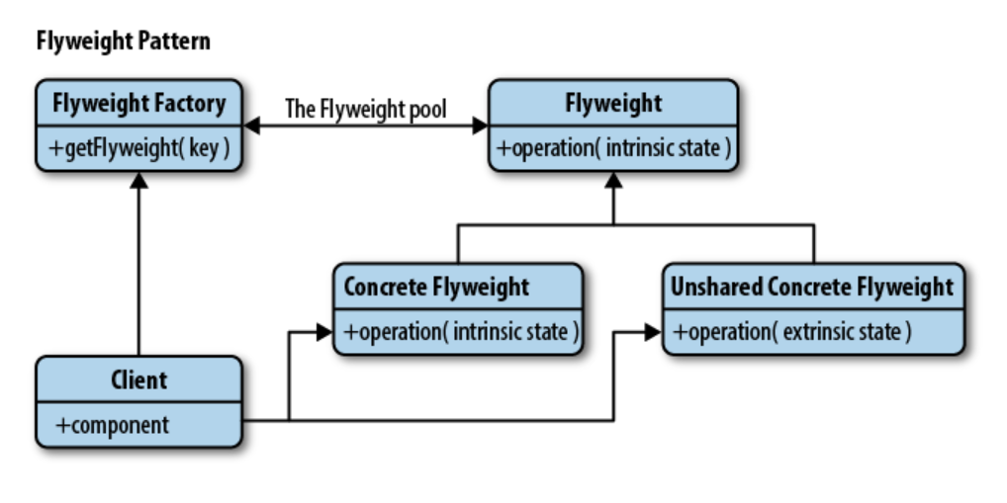
Flyweight Pattern Diagram

Slide 6
Participants
Client:
calls into FlyweightFactory to obtain flyweight objects
FlyweightFactory:
creates and manages flyweight objects
if requested, and a flyweight does not exist, it will create one
stores newly created flyweights for future requests
Flyweight:
maintains intrinsic data to be shared across the application

Slide 7
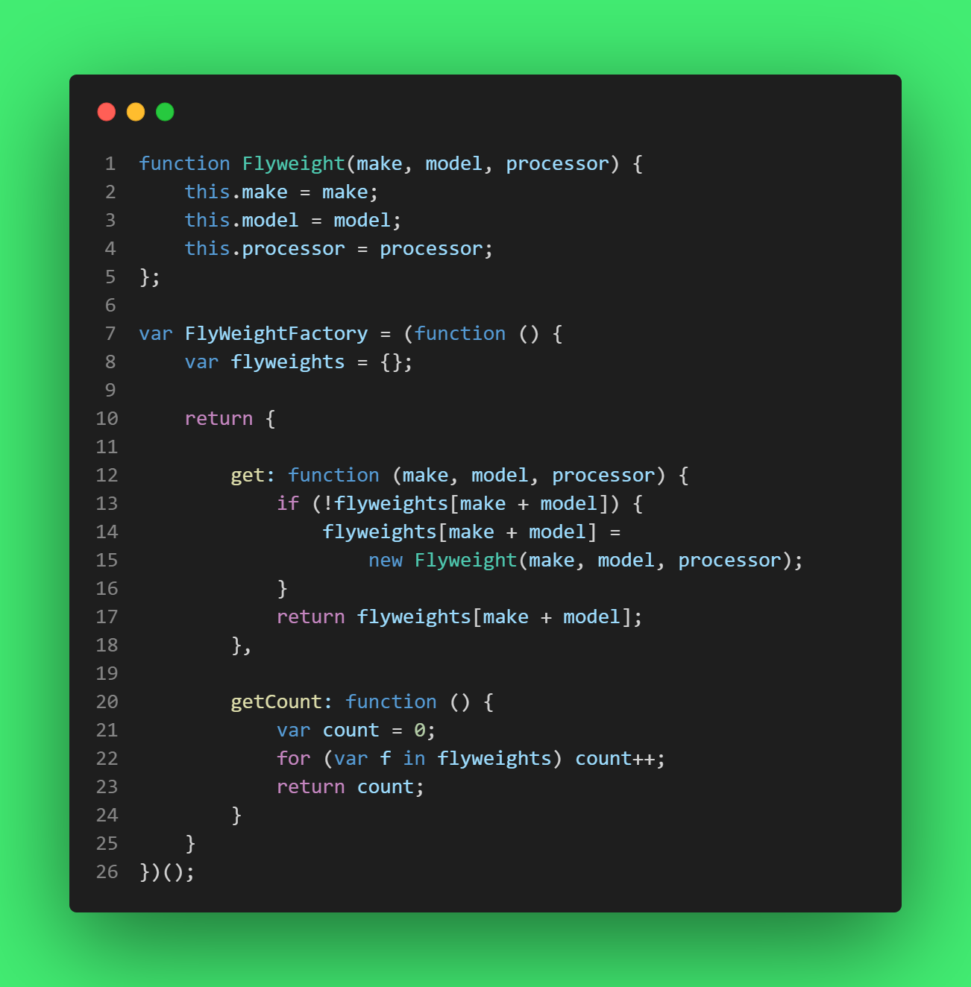
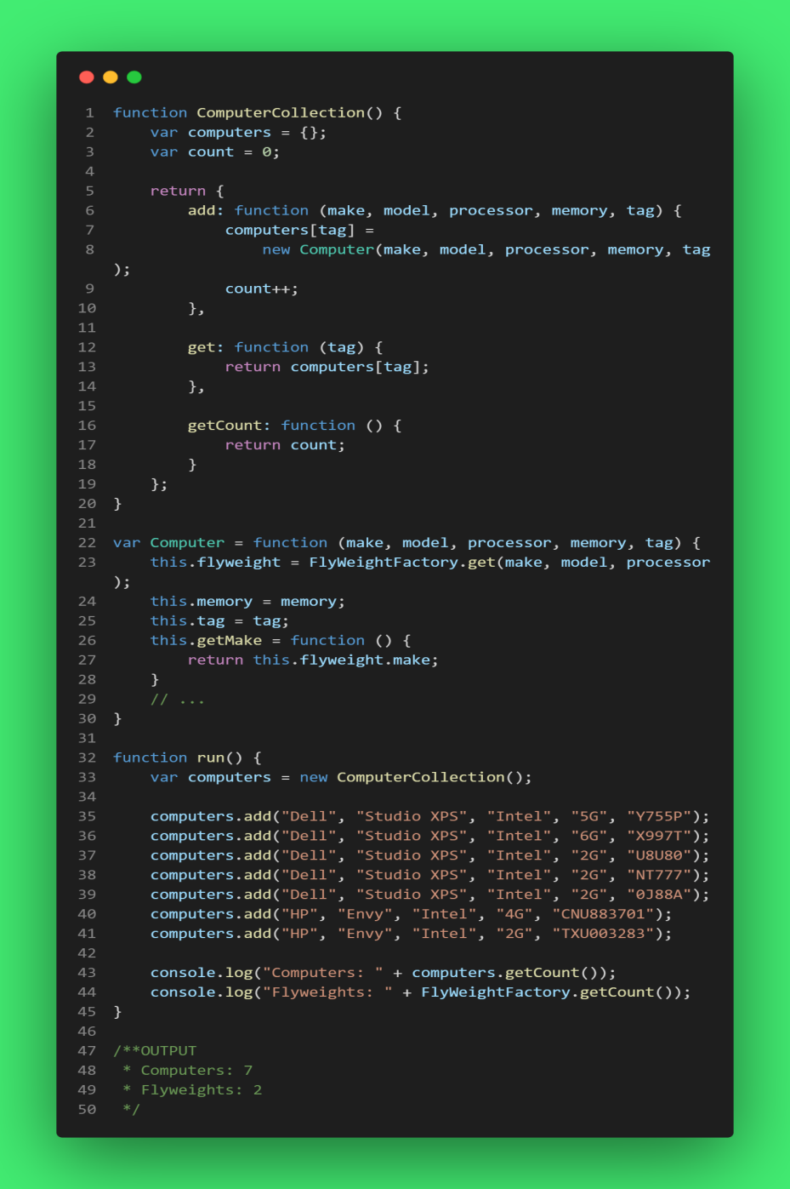
Example

Slide 8
Useful Resoucres
https://www.oreilly.com/library/view/learning-javascript-design/9781449334840/ch09s18.html
https://www.patterns.dev/posts/classic-design-patterns/#detailflyweight
https://www.dofactory.com/javascript/design-patterns/flyweight

